Slide 1
TRANSITION ELEMENTS

Slide 2
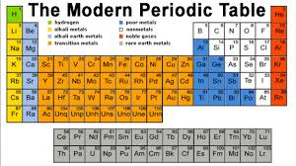
( d block elements)

Slide 3
Properties Of Transition Elements
Electronic Configuration
(n-1)d¹⁻¹⁰ ns¹⁻²
Exceptions:
a)Zn, Cd and Hg has completely filled d-orbitals. Hence these elements are not considered as transition elements.
b)Cr and Cu electronic configuration
Cr :3d⁵ ,4s¹ instead of 3d⁴ ,4s²

Slide 4
Cu :3d¹⁰ ,4s¹ instead of 3d⁹ ,4s²
Due to very little energy difference between (n-1) and ns orbitals, this can be explained on the basis of electronic repulsion and energy exchange ,which proves that half- filled and full filled d-orbitals are more stable configuration.

Slide 5
MAGNETIC PROPERTY
On applying a magnetic field to substances, two types of magnetic behaviour are observed as diamagnetism and paramagnetism.
The magnetic moment is related to the number of unpaired electrons.
Magnetic moment = √n*(n+2) BM, where n: number of unpaired electron.

Slide 6
The transition metal ions generally contain one or more unpaired electrons in them and hence their complexes are generally paramagnetic. The paramagnetic character increases with increase in number of unpaired electrons. The paramagnetism is expressed in terms of magnetic moment.

Slide 7
COMPLEX FORMATION
Transition element from many co-ordination complex. Their tendency to form complex is due to following reasons:
Size and high charge density of the ions of transition metals
Presence of vacant orbitals of appropriate energy which can accept lone pairs of electrons donated by other groups (ligands).

Slide 8
CATALYTIC PROPERTIES
Many transition metals and their compounds are known to act as catalysts.
The catalytic activity of transition metals is due to the following reasons: 1) because of their variable valencies.
2) some transition metals provide a suitable surface for the reaction to take place.

Slide 9
INTERSTITIAL COMPOUNDS
The transition elements are capable of entrapping smaller atoms of other elements such as H, C and N in the voids of their crystals lattices. These trapped atoms get bonded to the atoms of transition elements.
The interstitial compound are generally non-stoichiometric and are neither typically ionic non covalent.

Slide 10
FORMATION OF ALLOYS
The d-block elements have almost similar atomic sizes. Therefore, these elements can mutually substitute their positions in their crystal lattices. In this way, many alloys are possible between transition metals.

Slide 11
METALLIC CHARACTER
All transition elements are metallic in nature . Zn, Cd, and Hg are exceptions as they do not have typical metallic structures. Due to the presence of strong metallic bonds, the transition metals are haed, possess high densities and high enthalpies of atomisation.

Slide 12
MELTING AND BOILING POINT
The melting and boiling points of transition elements are generally very high because of stronger inter atomic bonding.
In moving along the period for left to right, the melting points of these metals first increase to maximum and then decrease regularly the end of the period

Slide 13
COLOURED COMPLEXES
The compounds of transition element are usually coloured. In the transition elements which have partly filled d-orbitals, the transition of electron can take place from one of the lower d-orbitals to some higher d-orbital within the same subshell.

Slide 14
The energy required for this transition falls in the visible reason. So when white light falls on these complexes they absorb a particular colour from the radiation for the promotion of electron and the remaining colours are emitted.the colour of the complex is due to this emitted radiation.

Slide 15
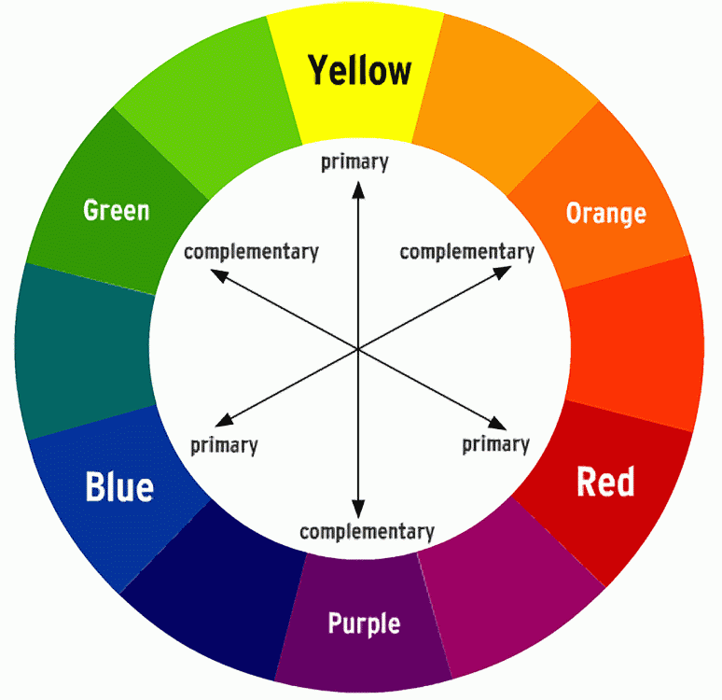
Complementary colours

Slide 16
ALPANA SHRIVASTAVA
PGT (CHEMISTRY)
KV DAMOH (M.P)

